Slide 1
DAY2

Slide 2
VOLTAGE & CURRENT

Slide 3
VOLTAGE & CURRENT
Voltage is the cause and current is the effect.
Voltage attempts to make a current flow and current will flow if the circuit is complete.
Voltage is some times described as ‘push’ or ‘force’ of electricity.
It is possible to have voltage without current, but cannot flow without voltage.

Slide 4
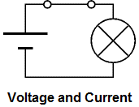
The switch is closed making a complete circuit so current can flow

Slide 5
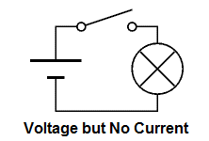
The switch is open so the circuit is broken and current cannot flow.

Slide 6
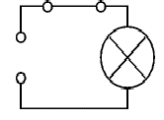
Without the cell there is no source of voltage so current cannot flow.

Slide 7
REGULATED DC POWER SUPPLY

Slide 8
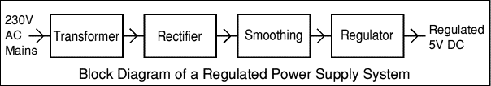
REGULATED DC POWER SUPPLY

Slide 9


12V
7812
R1
C1
C2
C
R2
7805
5V
C=1000uF C1,C2=104pF R1,R2=330

Slide 10
RECTIFIER:
The primary application of rectifiers is to derive usable DC power from an AC supply. Virtually all electronics except simple motor circuits such as fans require a DC supply but mains power is AC so rectifiers find uses inside the power supplies of virtually all electronic equipment.

Slide 11
FILTERS
Electronic filters are electronic circuits which perform signal processing functions, specifically to remove unwanted frequency components from the signal, to enhance wanted ones, or both.
AC+DC
DC
AC
RECTIFIER
OUTPUT
FILTER
PURE DC

Slide 12
VOLTAGE REGULATOR
A voltage regulator is an electrical regulator is designed to automatically maintain constant voltage levels.
Depending upon the design it may be used to regulate ac or dc voltages.

Slide 13
Why Bridge rectifier preferred over center tapped rectifiers?
As center tap rectifier is bulky due to a transformer which should be center taped and also this transformer cost is more than simple transformer.
In case of bridge wave rectifier transformer we use is simple and not so expensive.

Slide 14
Why bridge rectifier is preferred over half wave rectifiers?
The AC supply delivers power only half the time, therefore the output is low and the Rectifier Efficiency is only 40.6%.

Slide 15
Why C filter is preferred over all other filters?
The heat emission in the R filter is more , so it may damage the circuit.
The cost of the copper coil is very expensive and its weight is also very high , so we cannot use LC filters.

Slide 16
How to choose the value of capacitor?
Depending upon the voltage of the circuit.
More the value of rectification more will be the value of capacitor.

Slide 17
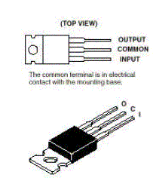
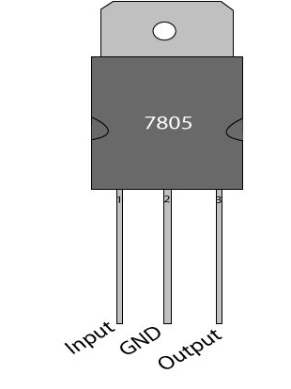
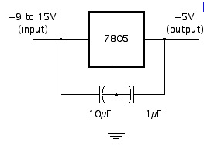
7805 voltage regulator:

Slide 18
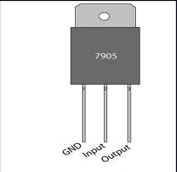
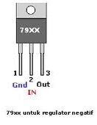
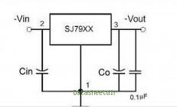
7905 voltage regulator:

Slide 19
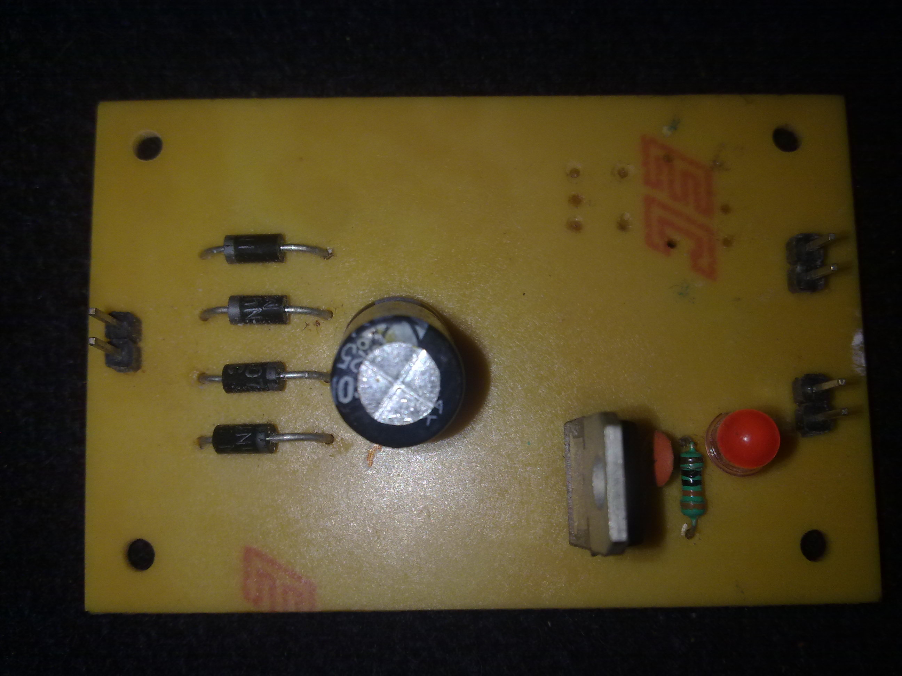

Slide 20
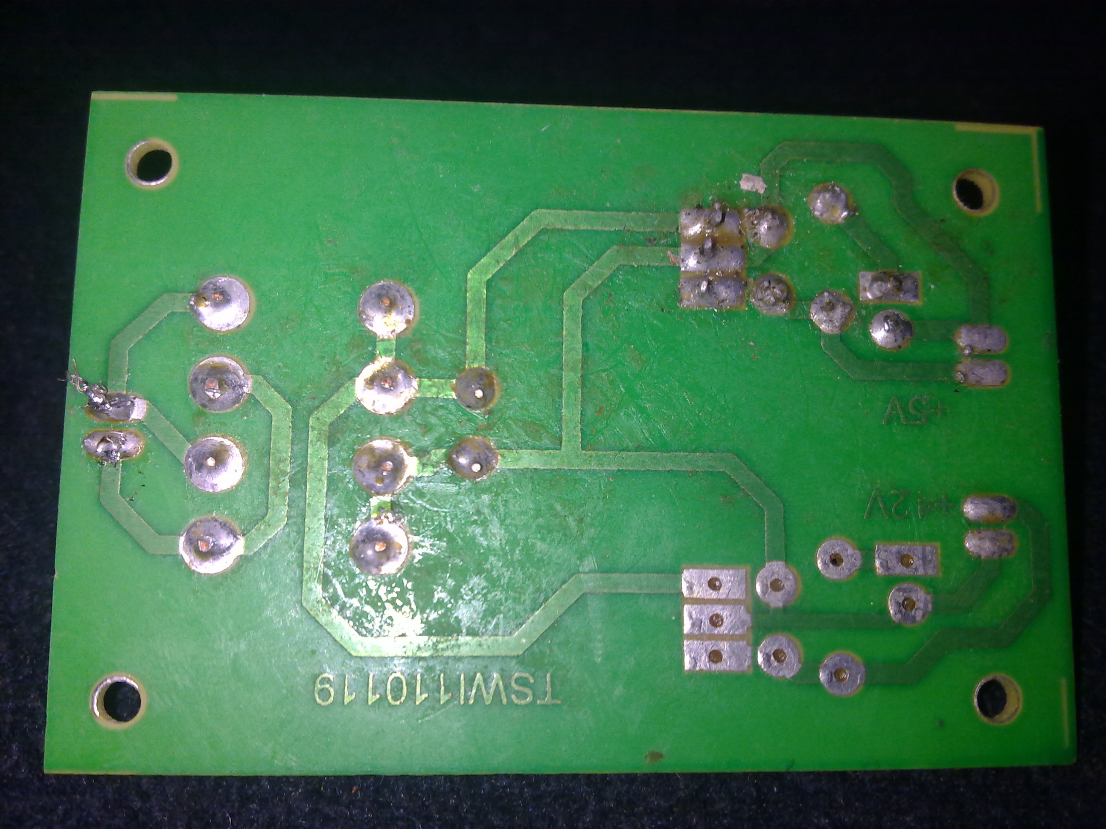

Slide 21
What is a rechargeable battery?
A rechargeable battery or storage battery is a group of one or more electrochemical cells. They are known as secondary cells because their electrochemical reactions are electrically reversible.
Rechargeable batteries come in many different shapes and sizes, ranging anything from a button cell to megawatt systems connected to stabilize an electrical distribution network.

Slide 22
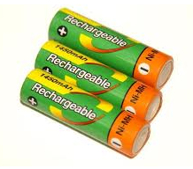
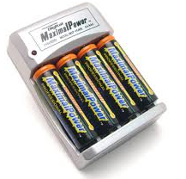
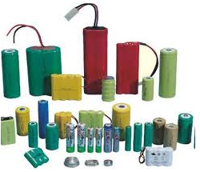

Slide 23
Purpose of resistor connected in series with LED:
The voltage of LED is 2.2V ,but the input voltage we use for the circuits is 5V or 12V . If the resistor is not connected in series with LED, it will get damaged due to high voltage.

Slide 24
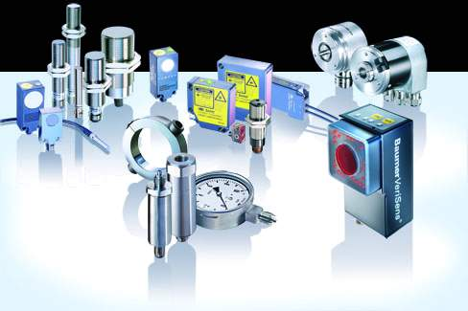
SENSORS

Slide 25
Sensors are also called as Transducers, which converts the given form of energy into electrical form.
TRANSDUCER
TEMPARATURE
ELECTRICAL FORM

Slide 26
TYPES OF SENSORS
Piezo electric sensor
Tilt sensor
Temperature sensor
Slot sensor
LPG sensor
PIR sensor
Magnetic sensor
Ultra sonic sensor
Inertial sensor

Slide 27
IR sensor
Inertial sensor
Alcoholic sensor
Tactile sensor
Force senstive sensor

Slide 28
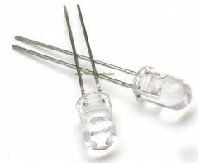
IR LED/PHOTO LED
A Infrared sensor (IR sensor) is an electronic device that measures infrared (IR) light radiating from objects in its field of view.
It is a special purpose LED that transmits infrared rays in the range of 760 nm wavelength.
An IR LED is also known as IR transmitter.

Slide 29
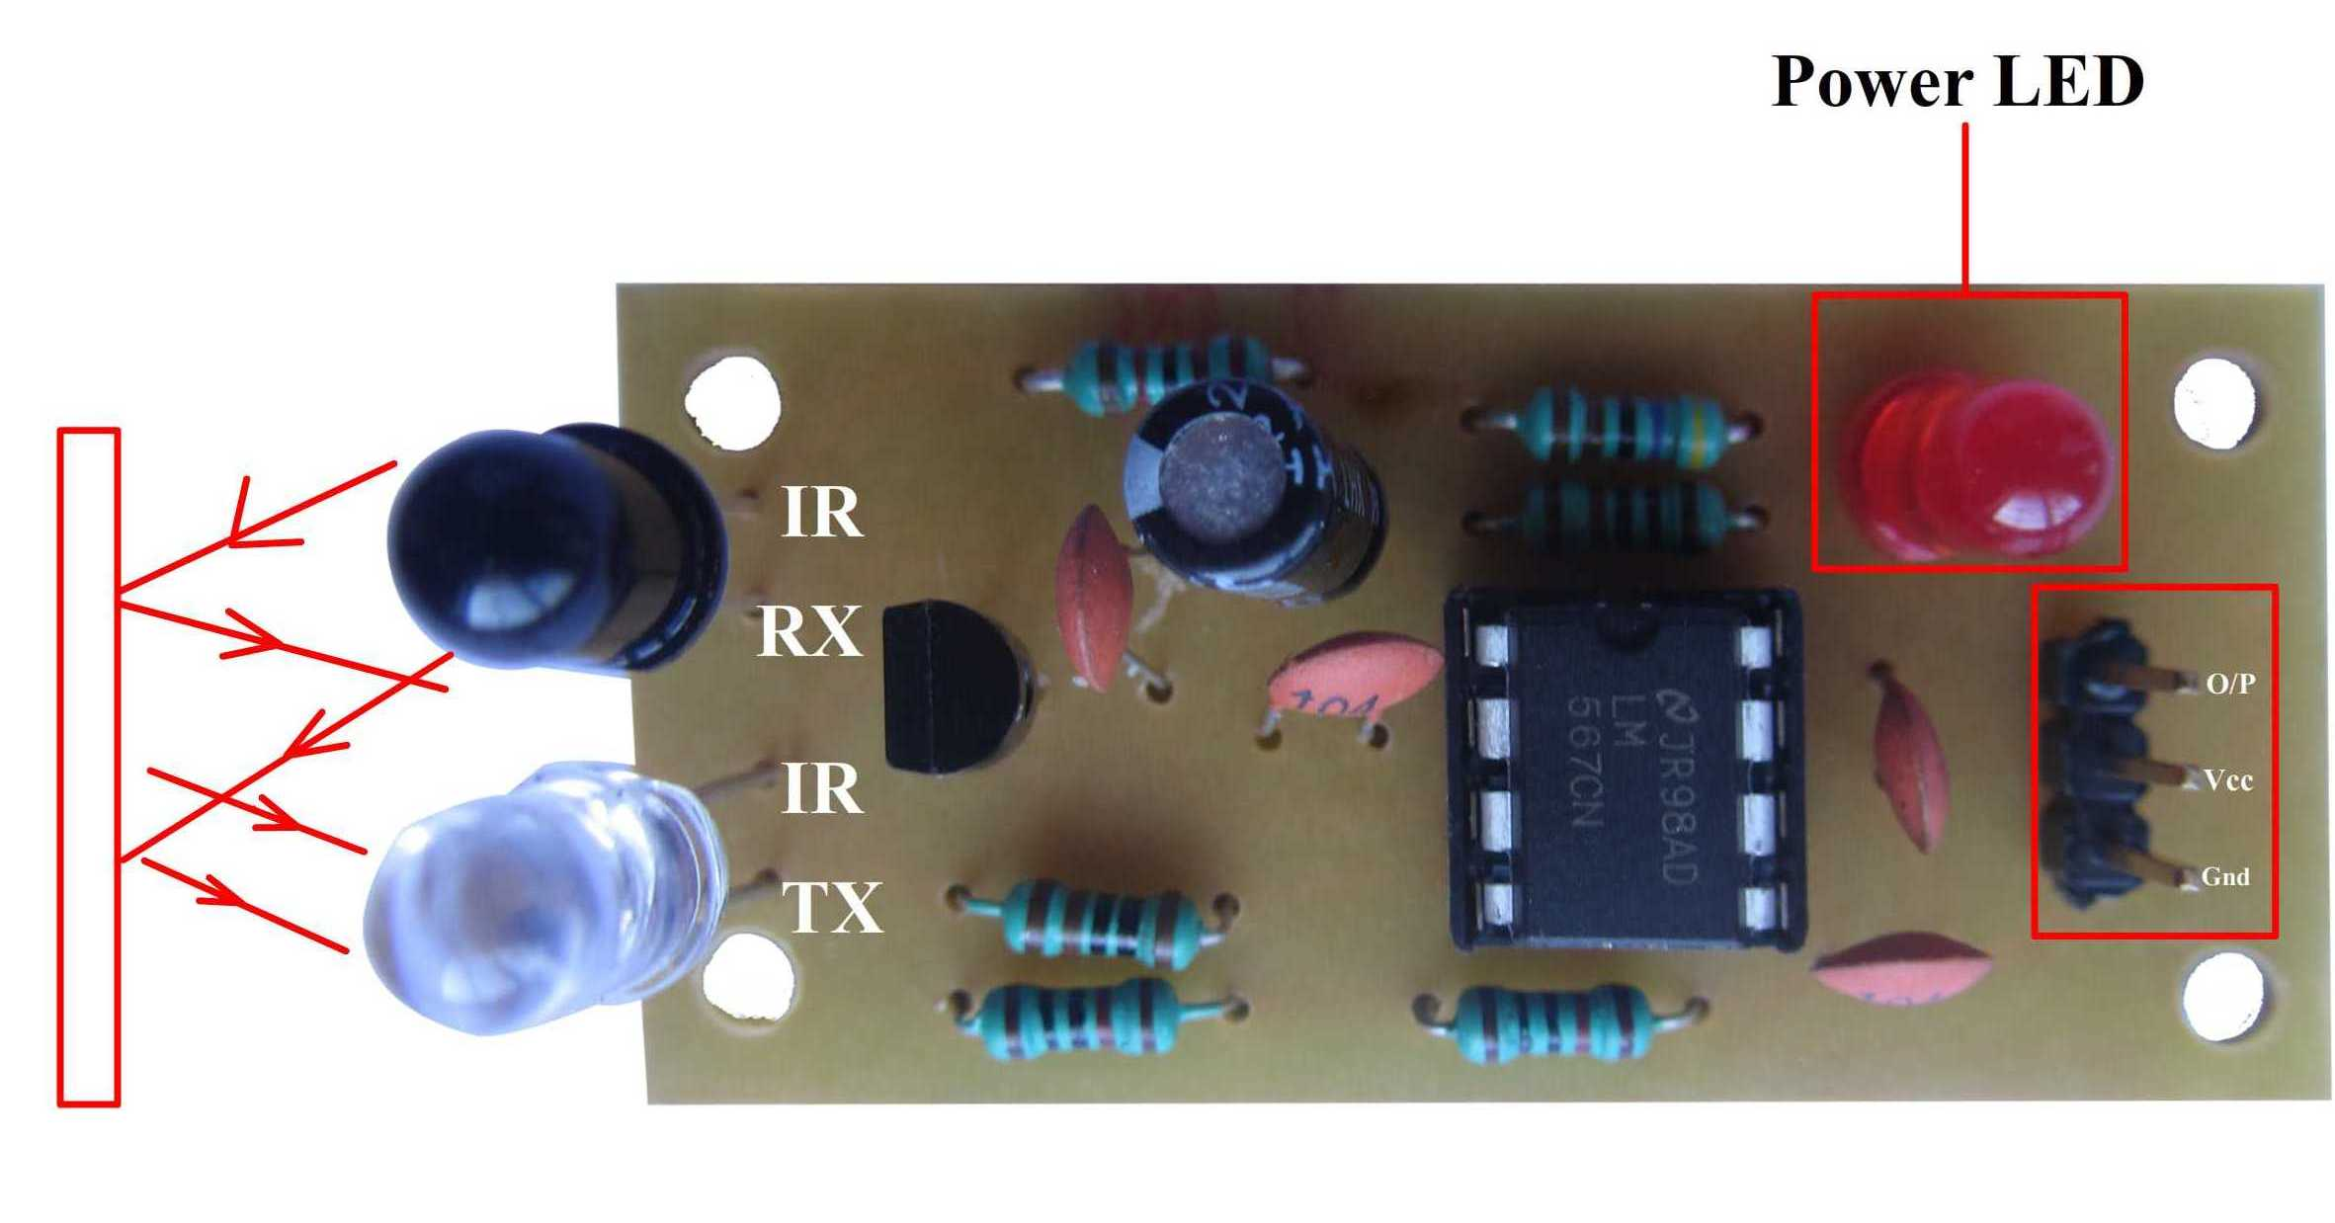

Slide 30
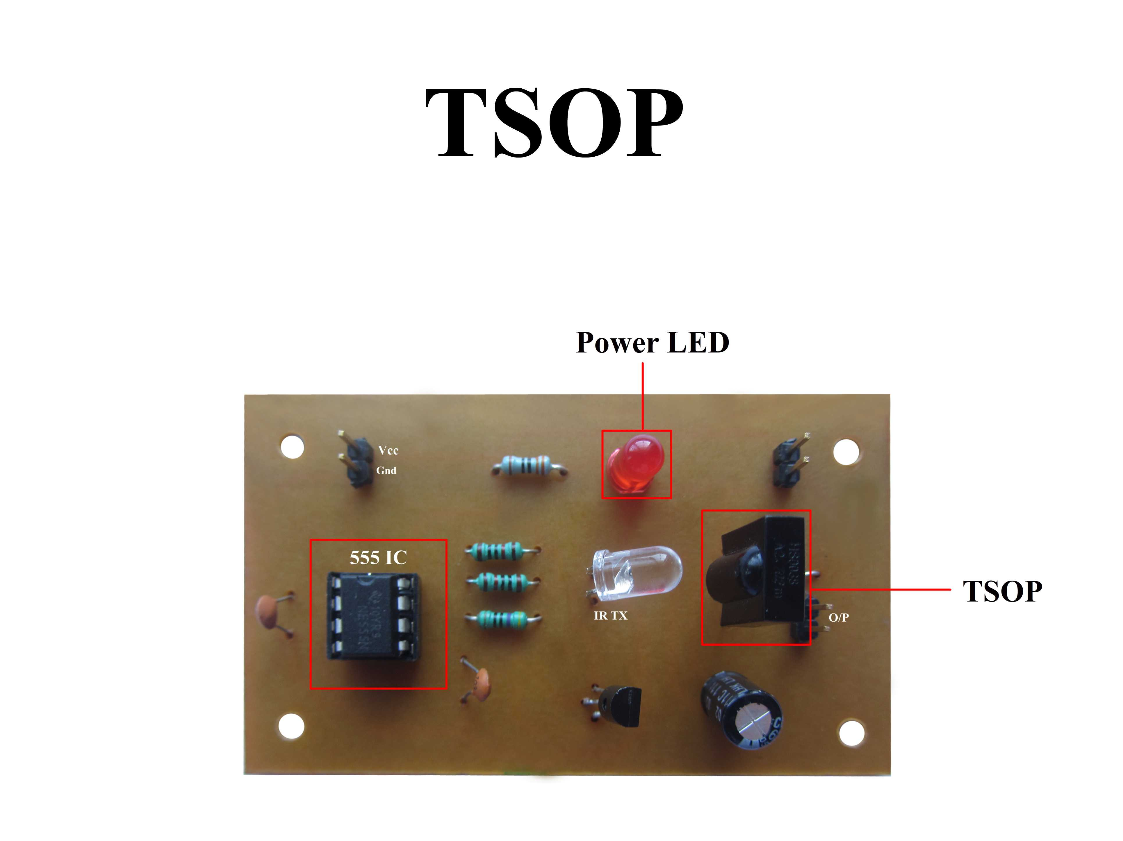

Slide 31
TEMPERATURE SENSOR
Temperature sensor converts the temperature into electrical signal called thermistor.
For examples transducer converts physical data such as temperature, light intensity ,flow and speed to electric signals.

Slide 32
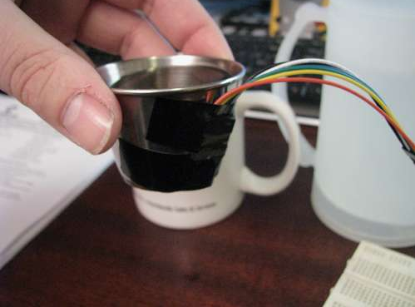
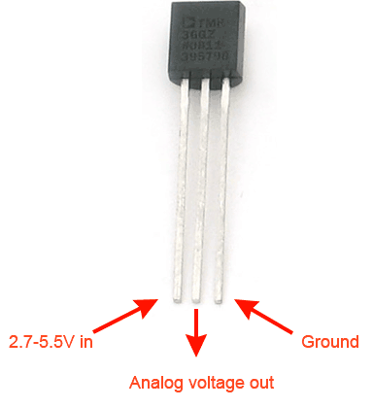
LM 35

Slide 33
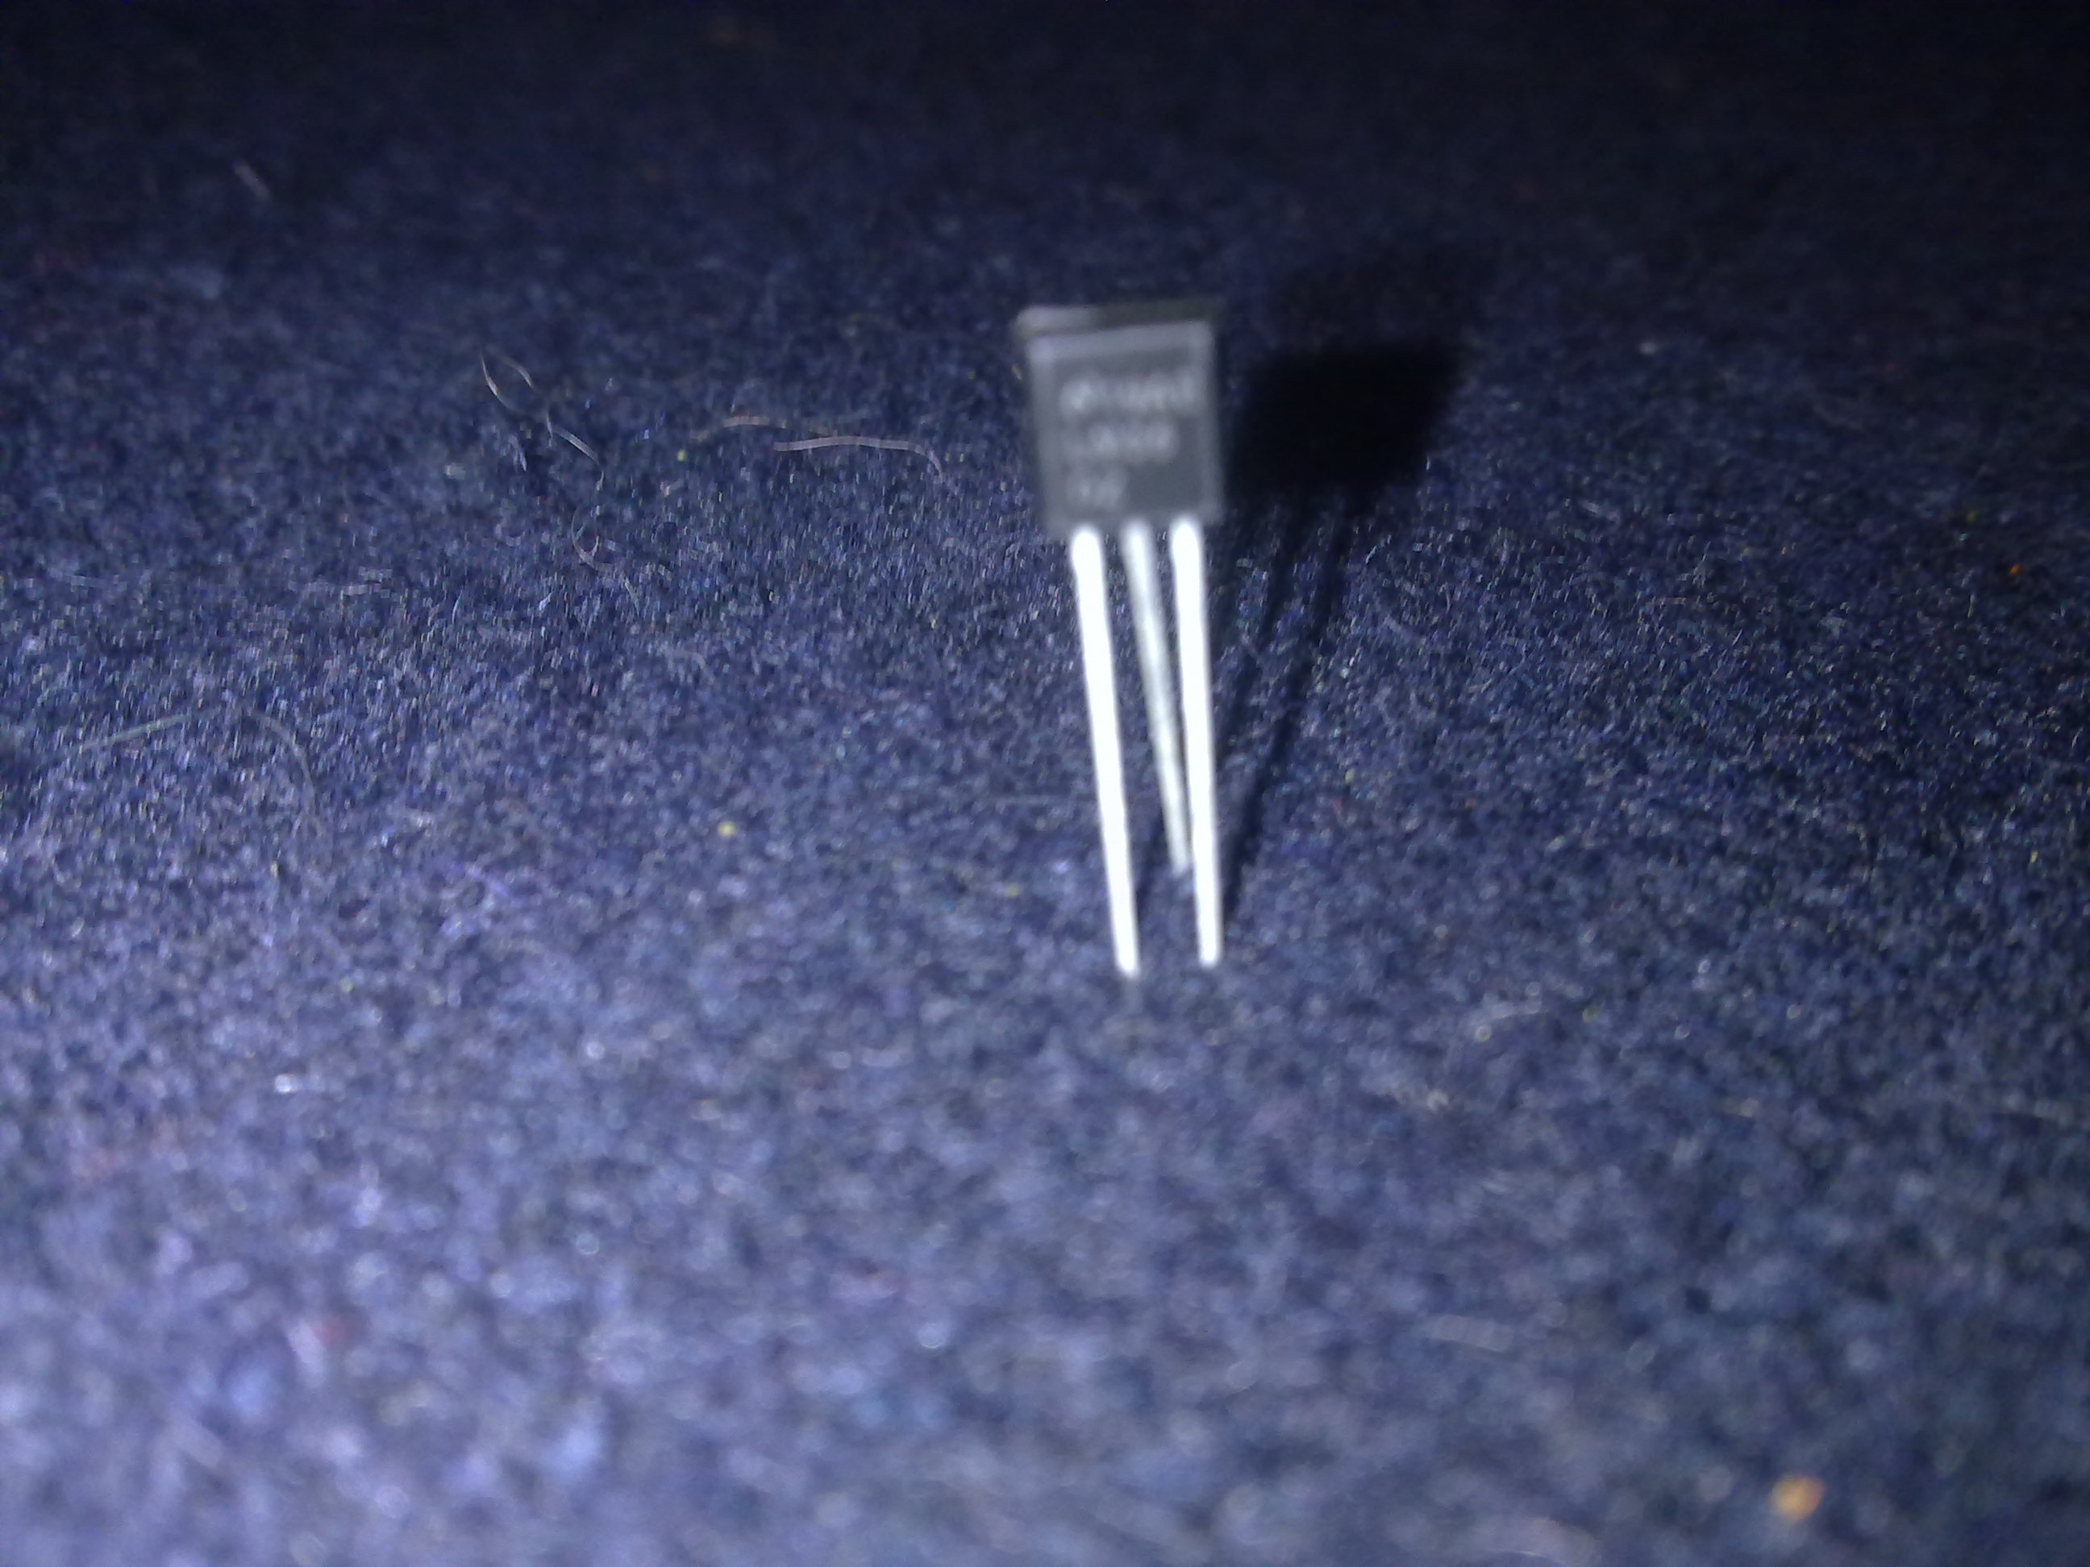

Slide 34
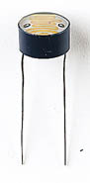
LDR
An LDR is an input transducer (sensor) which converts brightness (light) to resistance. It is made from cadmium sulphide (CdS) and the resistance decreases as the brightness of light falling on the LDR increases.

Slide 35
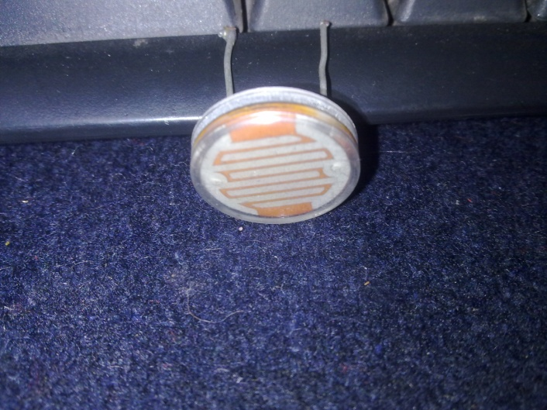

Slide 36
PIEZO ELECTRIC SENSOR
A piezoelectric substance is one that produces an electric charge when a mechanical stress is applied (the substance is squeezed or stretched).
Conversely, a mechanical deformation (the substance shrinks or expands) is produced when an electric field is applied.
Tactile Sensor:-

Slide 37
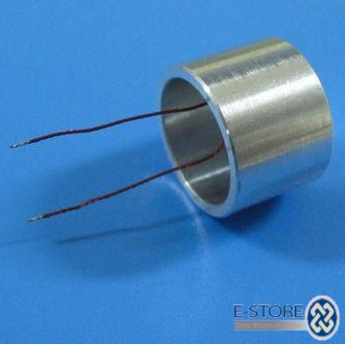
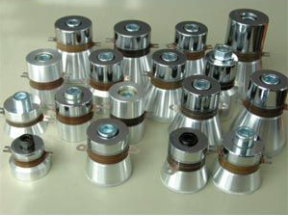
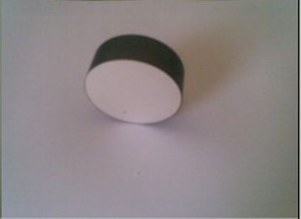
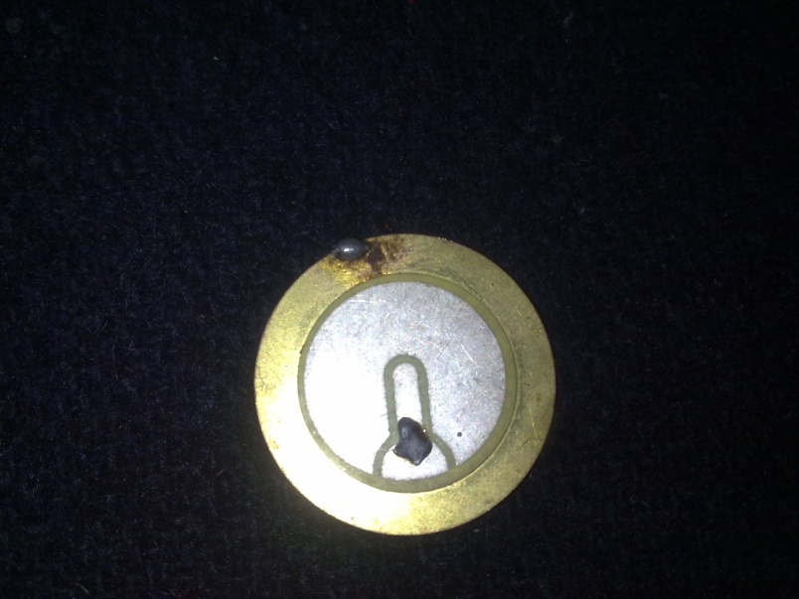

Slide 38
Inertial Sensor:- used in MEMS Technology Ultra sonic Sensor:- used for transmission and receiving pulse

Slide 39
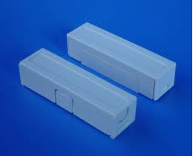
Magnetic Switch /Reed Switch
A magnetic switch, which consists of an enclosure and a contact

Slide 40
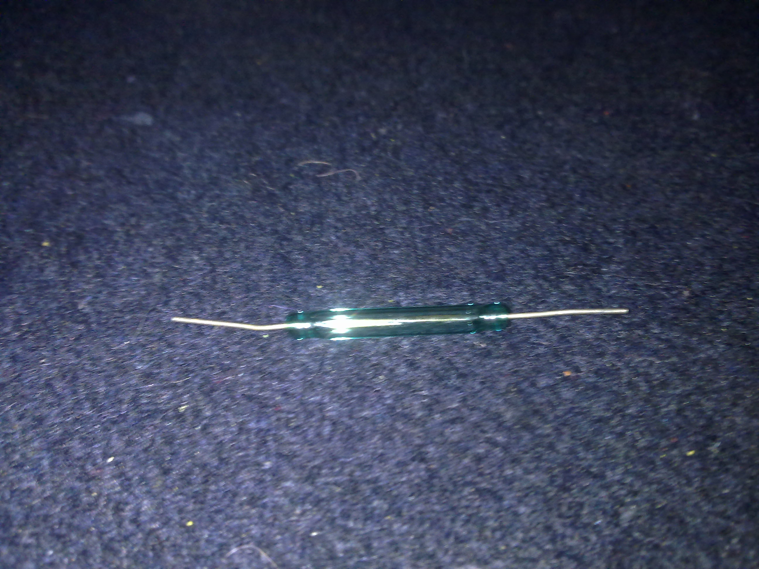

Slide 41
SLOT SENSOR
The main feature of our slot sensors is their reliability with utmost accuracy.
Even very small objects are reliably detected.

Slide 42
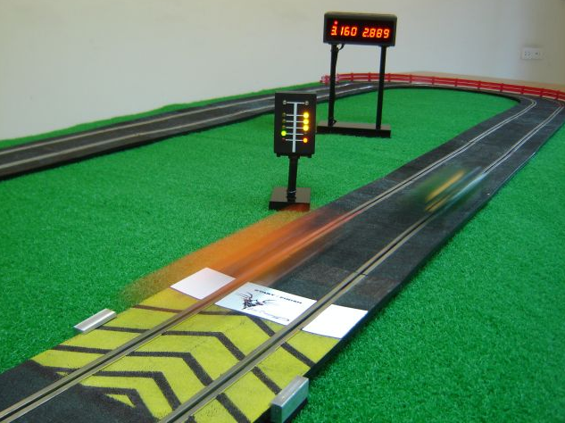
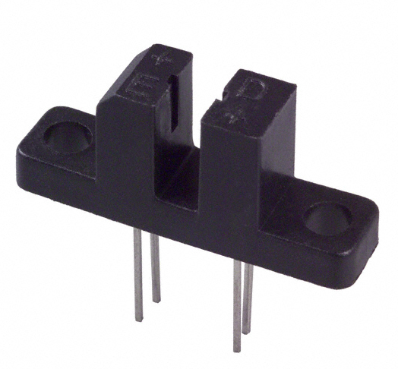

Slide 43
LPG SENSOR
LPG Sensor
Ideal sensor for use to detect the presence of a dangerous LPG leak in your car or in a service station, storage tank environment. This unit can be easily incorporated into an alarm unit, to sound an alarm or give a visual indication of the LPG concentration.
The sensor has excellent sensitivity combined with a quick response time. The sensor can also sense iso-butane, propane, LNG and cigarette smoke.

Slide 44
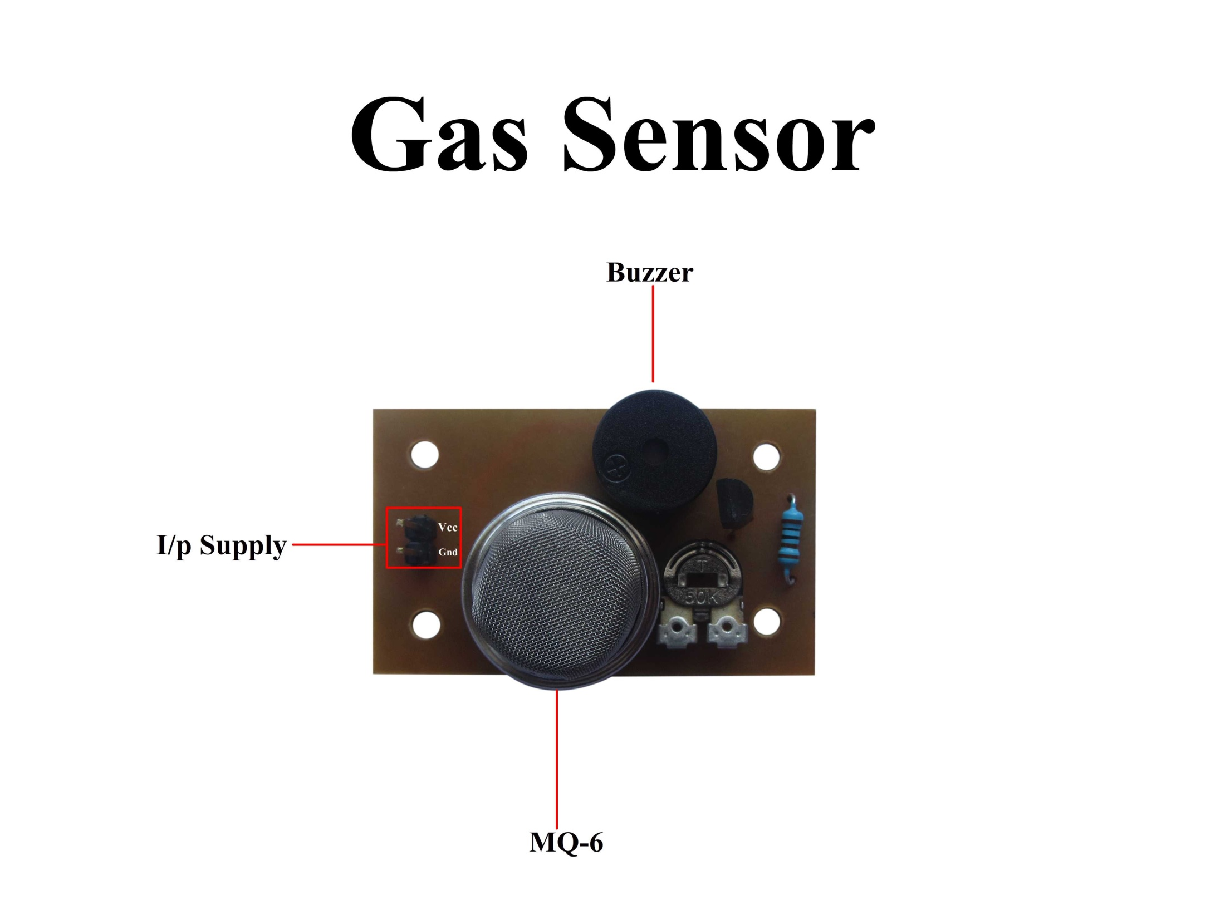

Slide 45
TILT SENSOR
A tilt sensor can measure the tilting in often two axes of a reference plane in two axes. In contrast, a full motion would use at least three axes and often additional sensors.
Application:
Tilt sensors can also be found in game controllers such as the Microsoft Sidewinder Freestyle Pro and Sony's PlayStation3 controller.

Slide 46
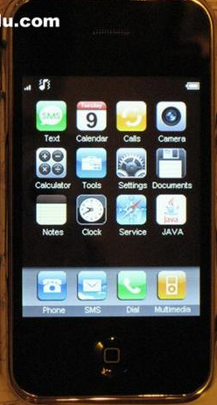
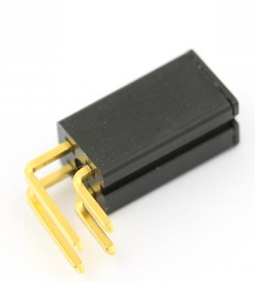

Slide 47
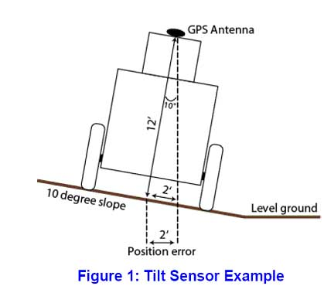

Slide 48
PIR SENSOR
The Passive Infrared Sensor (PIR) sensor module is used for motion detection. It can be used as motion detector for security systems or robotics.
It works form 3.3V to 5V DC and gives TTL output which can be directly given to microcontroller or to relay through a transistor.

Slide 49
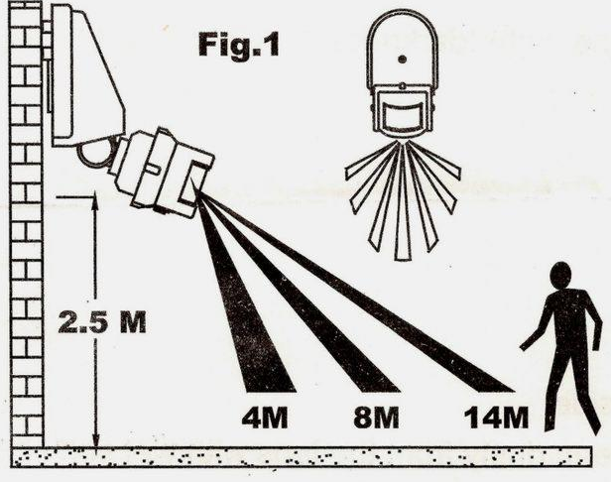
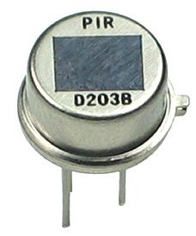

Slide 50
Sensors Demonstration

Slide 51
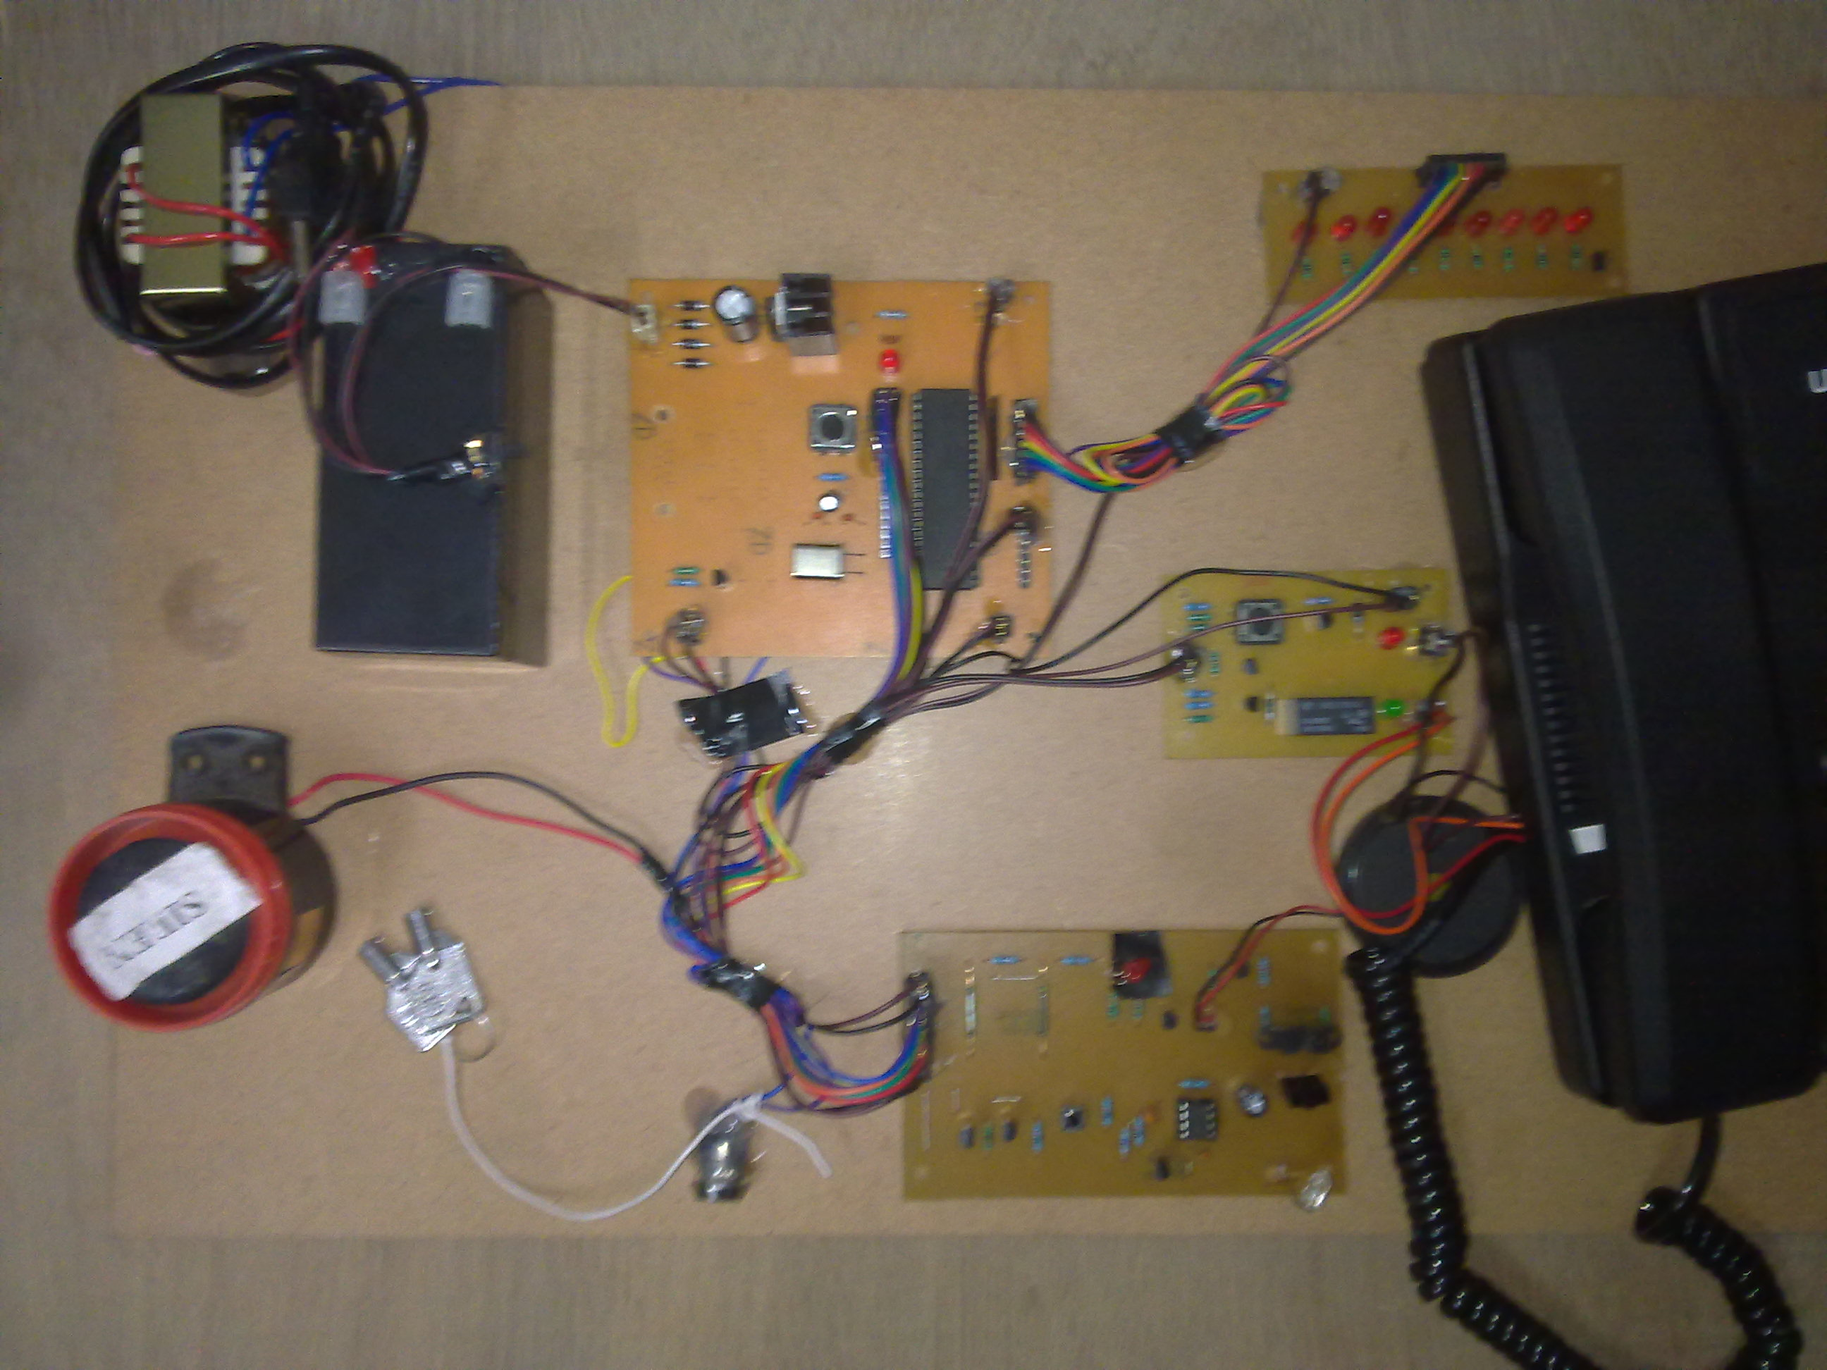

Slide 52
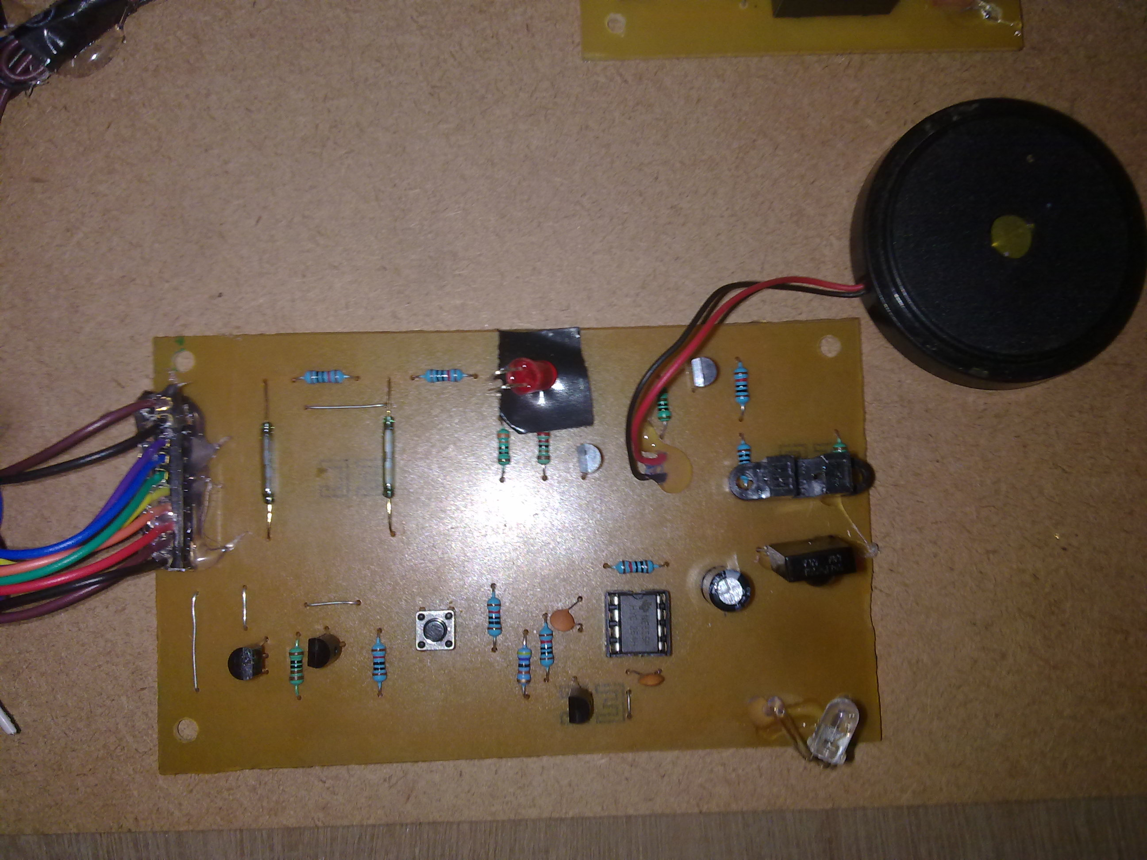

Slide 53
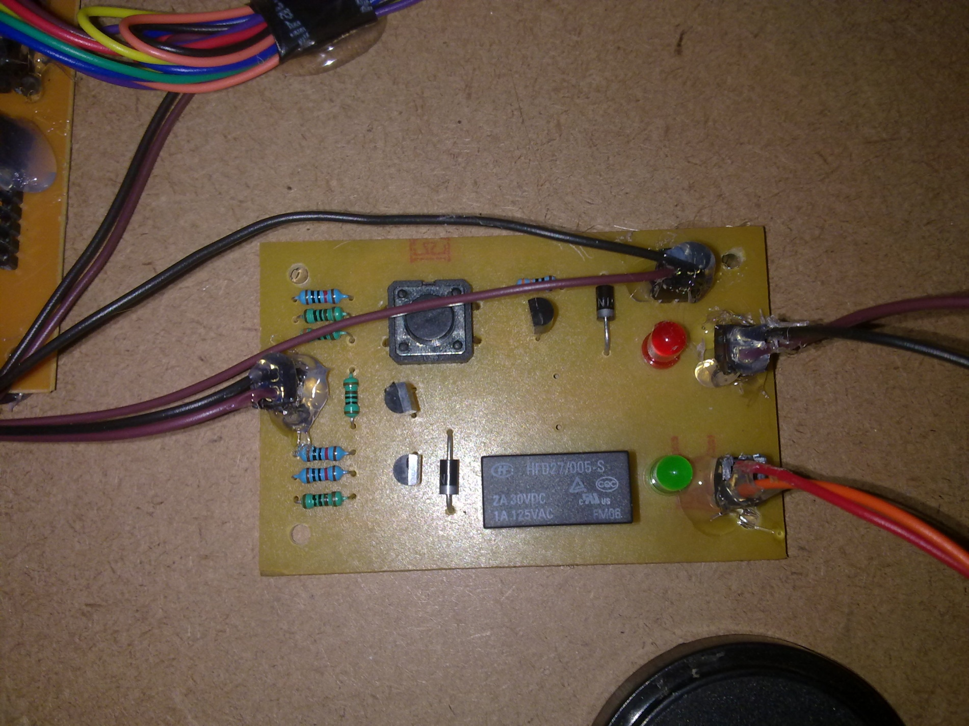

Slide 54
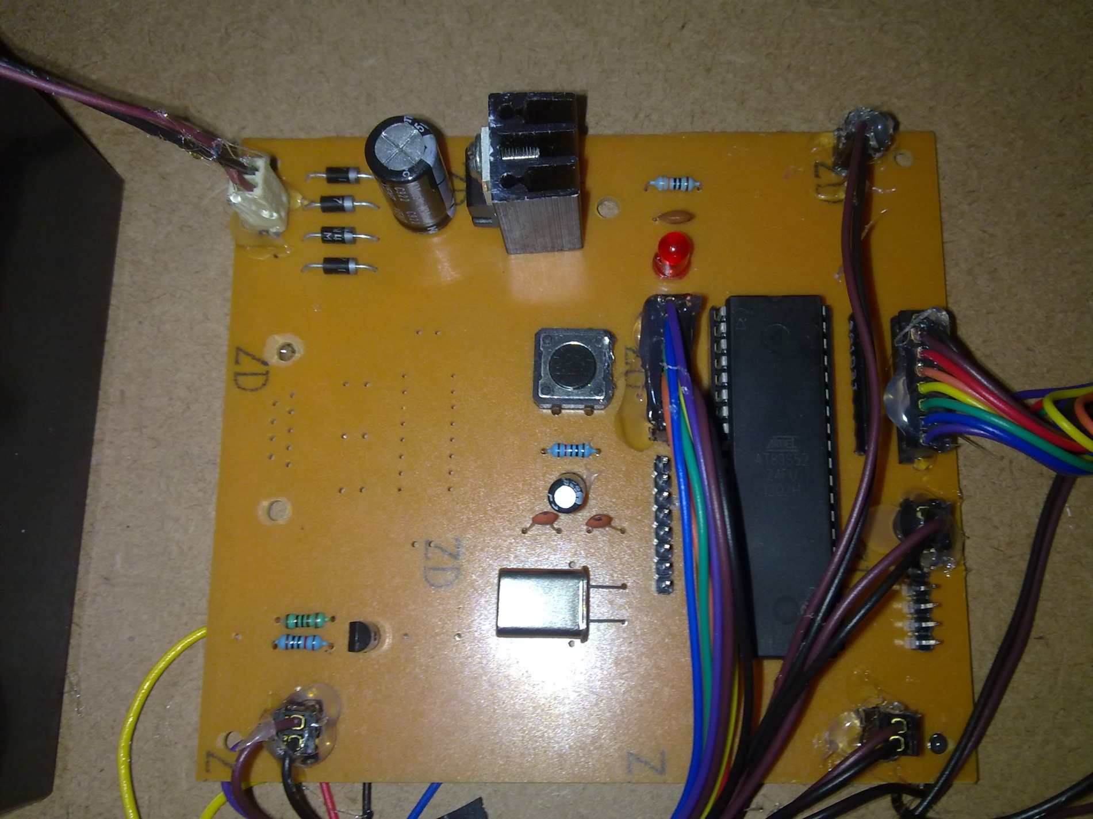

Slide 55
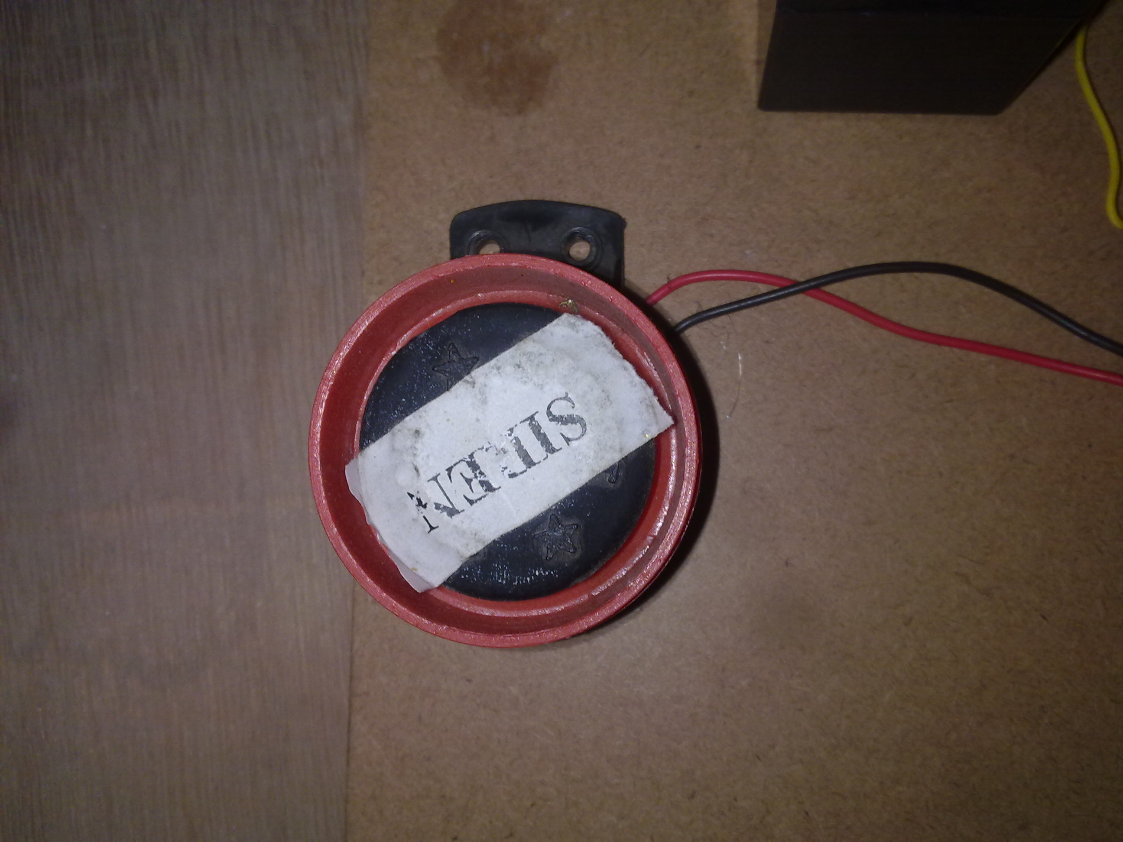

Slide 56
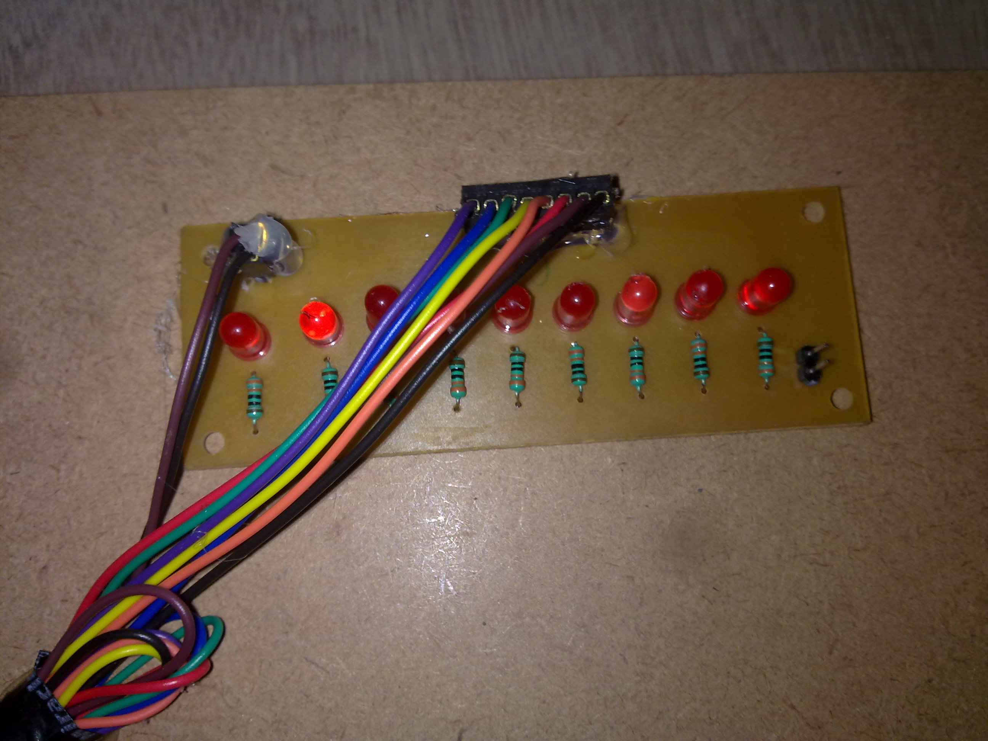

Slide 57
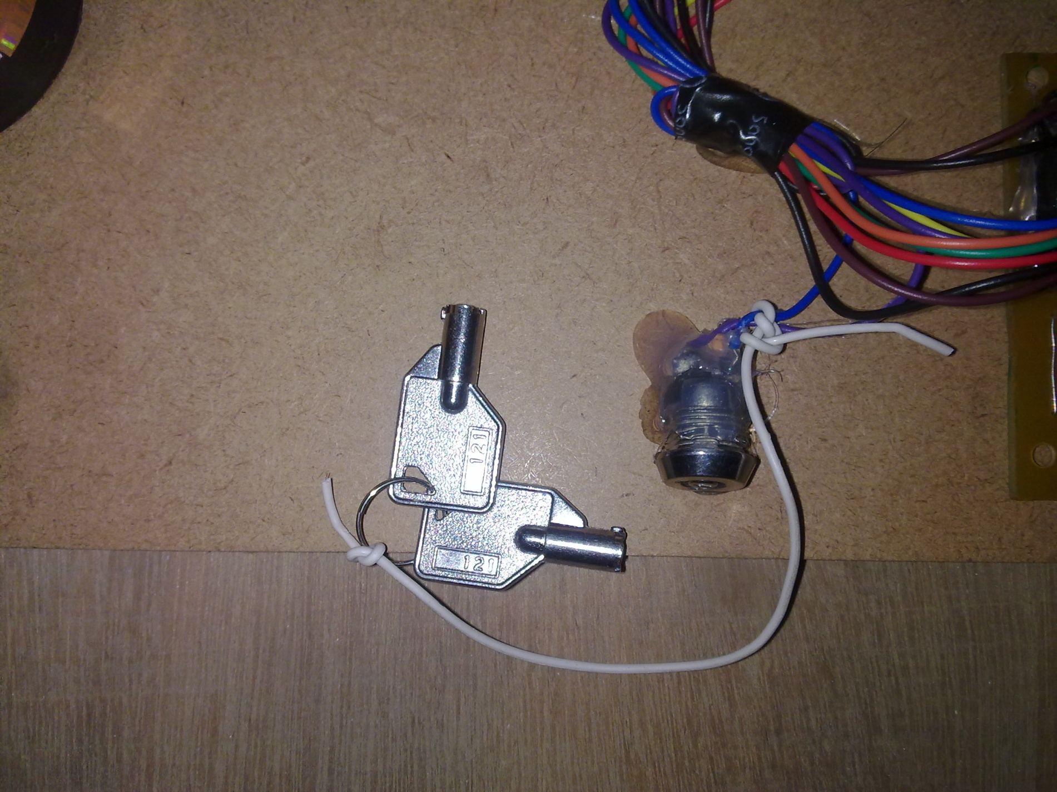

Slide 58
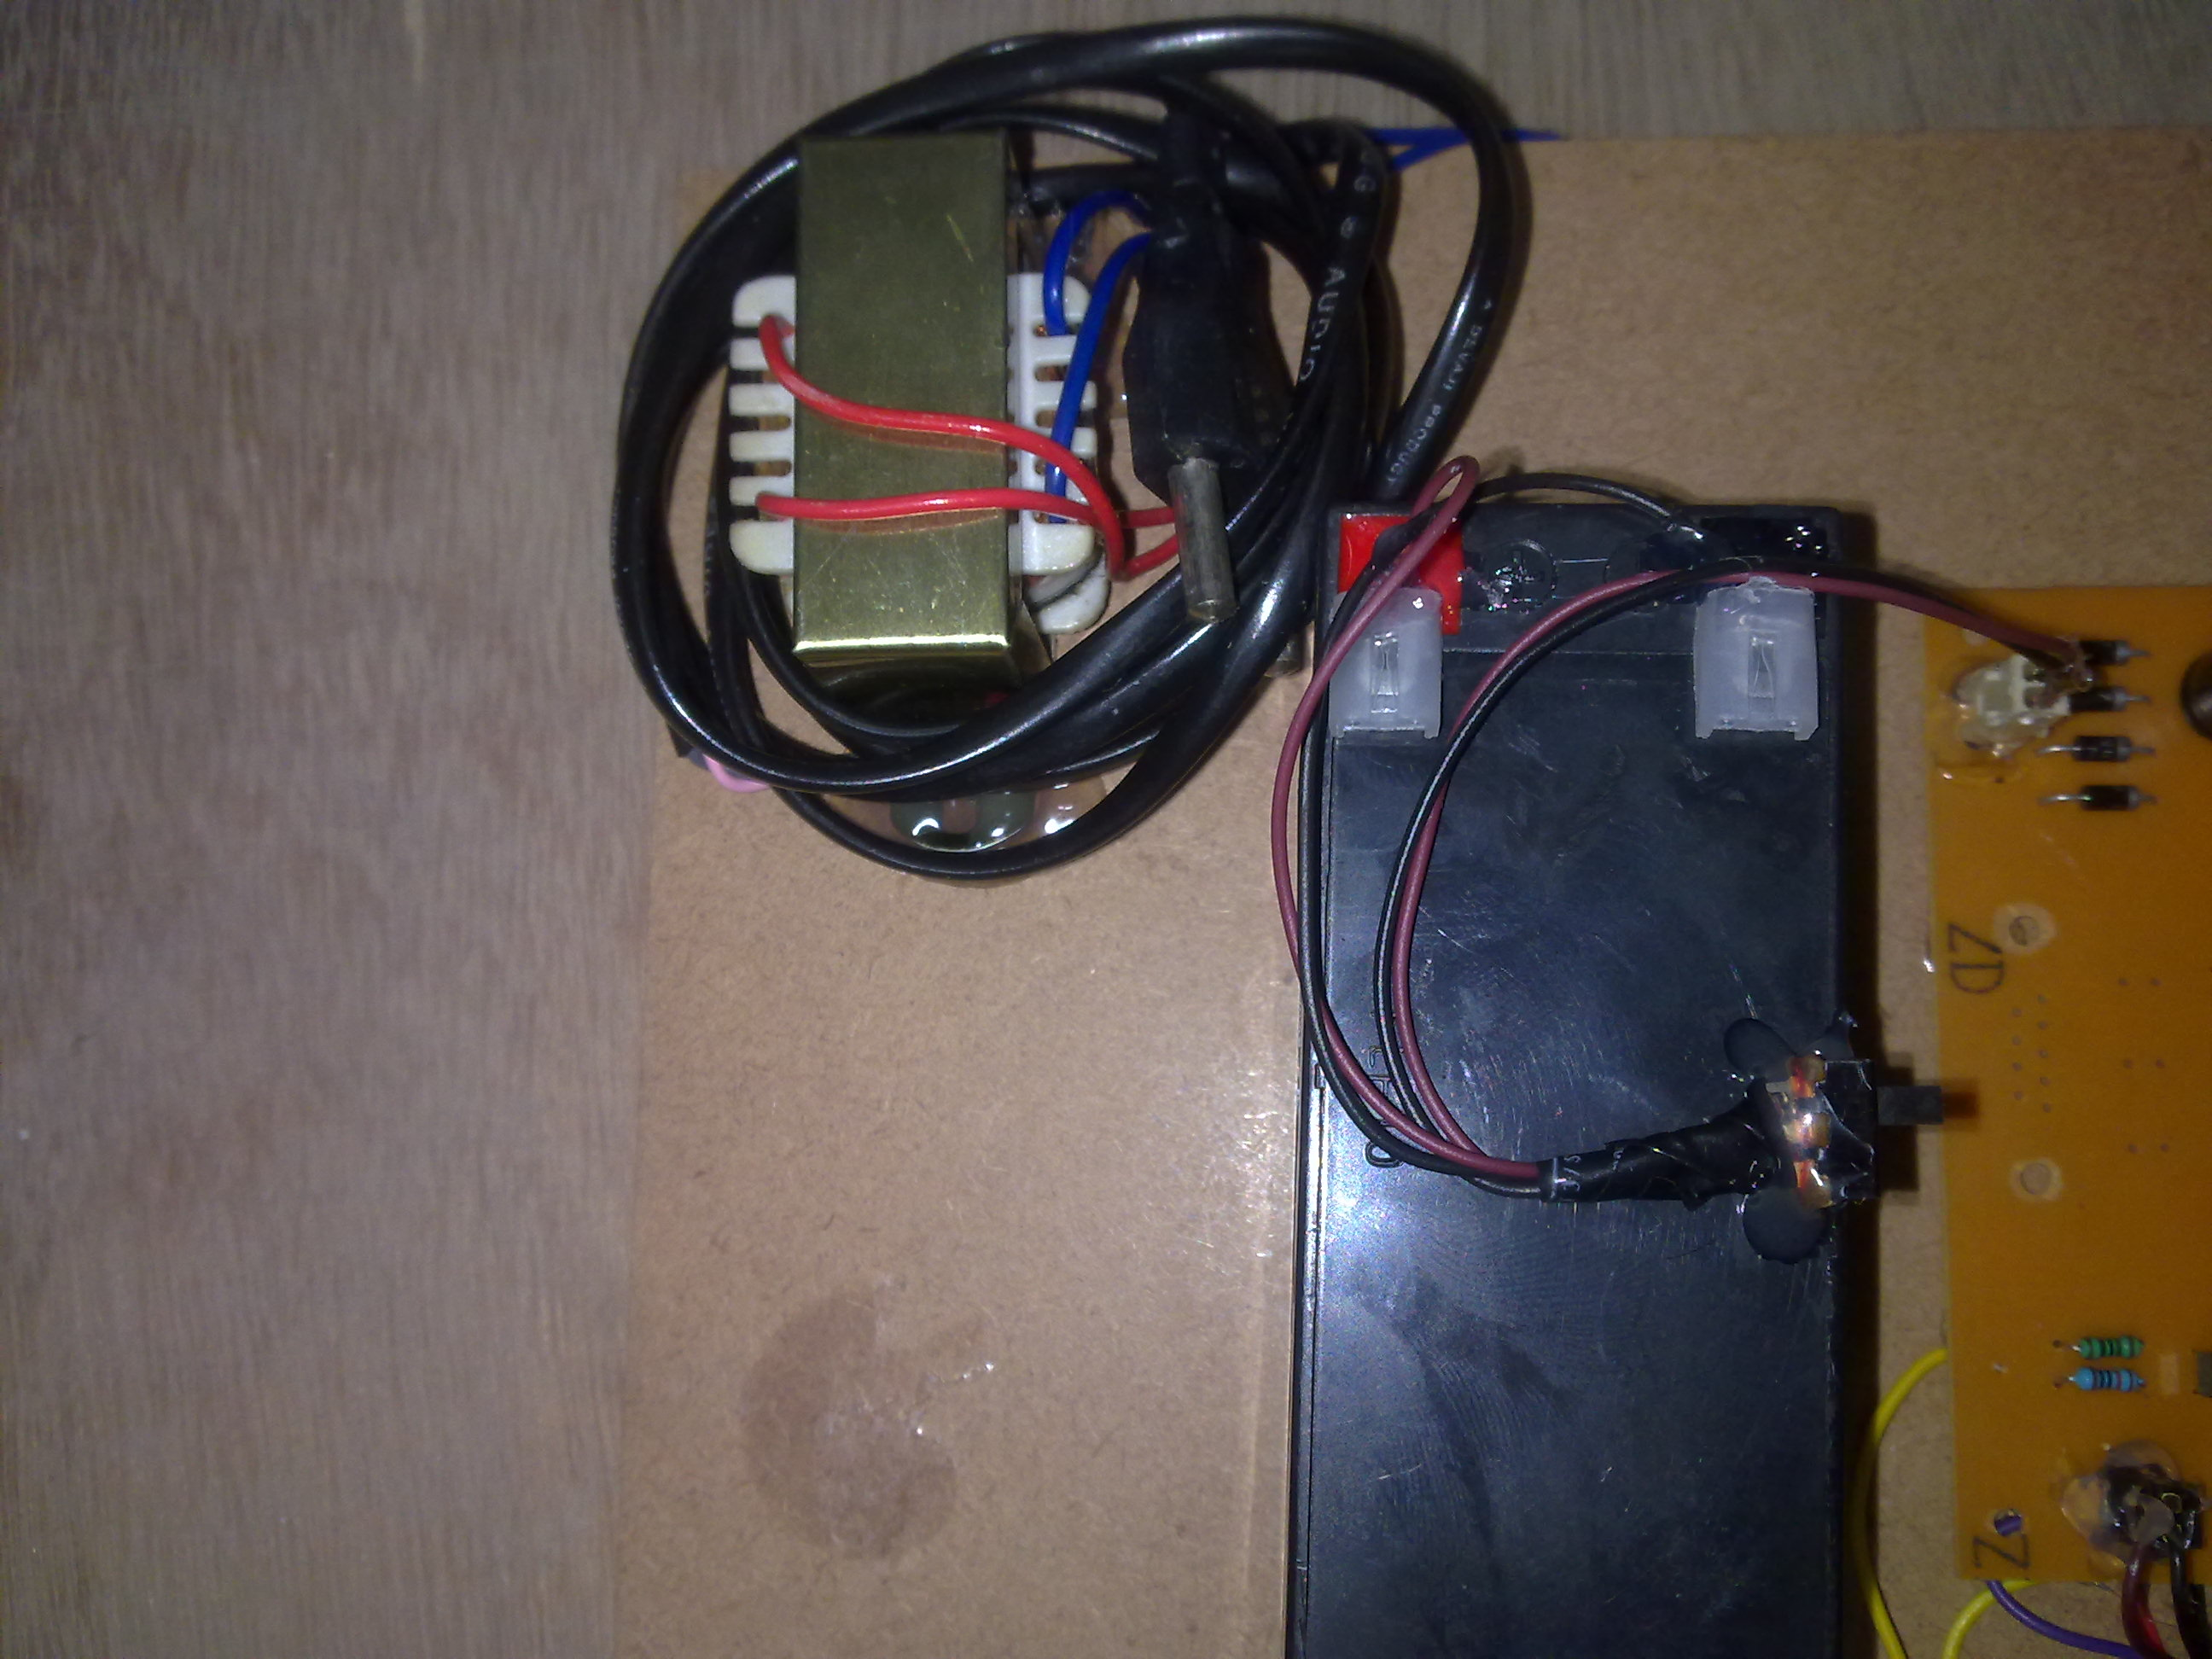

Slide 59
